Slide 1

EDA project
By - Harsh saurav

Slide 2
Analysis of Old Car Data
company:-Absolute Car

Slide 3



content
SL No. | CONTENT | Pages
1. | Introduction | 01
2. | Problem Statement | 02
3. | Cleaning Data | 01
4. | Brand and Drive | 01
5. | Car Count | 01
6. | Price | 01
7. | Engine Type | 01
8. | Body | 01
9. | Registration | 01
10. | Correlation | 01
11. | Conclusion | 01
12. | Actionable Insights | 01

Slide 4
Introduction
Dataset contains one of the used car company sales.
It contains approx. 9k records.
Few decades sale History available on this Dataset.
Visual Data Analysis.

Slide 5

Problem Statement
Cars Absolute, an American company buys and sells second hand cars.
The company has earned its name because of sincerity in work and quality of services. But for past few months their sales is down for some reason and they are unable to figure it out.
The company to tackle this problem and improve their business strategy and sells .

Slide 6
Problem Statement
Id | Feature | Description
01 | car | Car brand name
02 | model | Available car different Variants
03 | year | purchasing Year
04 | body | Body type-Hatchback, Sedan, Crossover etc
05 | mileage | car Mileage
06 | engV | Engine version
07 | engType | Car Fuel type - Petrol, Diesel, gas etc
08 | drive | Wheel Drive Front, back
09 | registration | Check if the vehicle is registered
10 | price | Price of Car in $

Slide 7
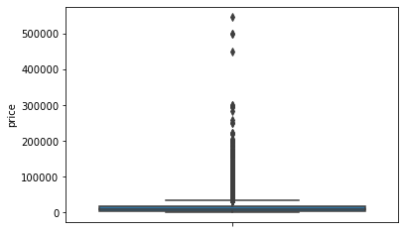
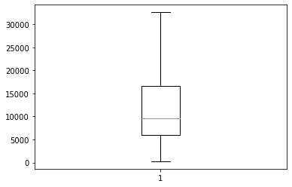
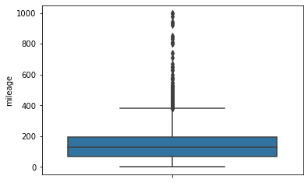
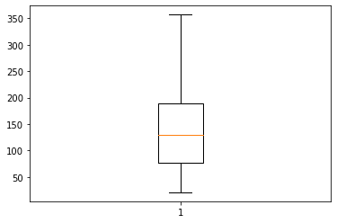
CLEANING DATA
BEFORE
AFTER
Price
mileage

Slide 8
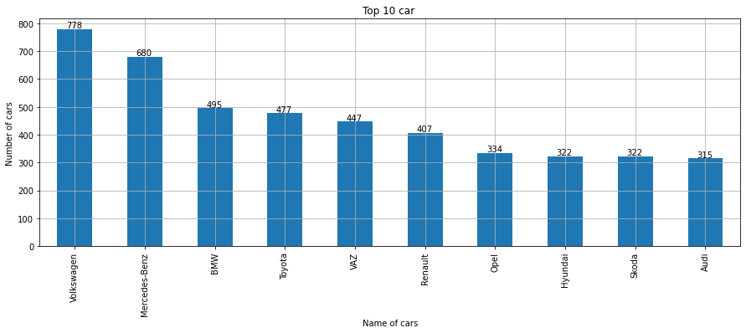
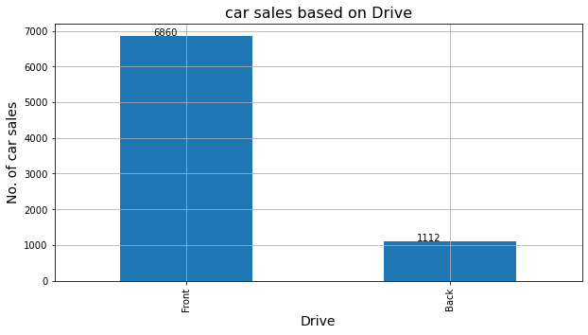
BRAND AND DRIVE
BRAND
DRIVE

Slide 9
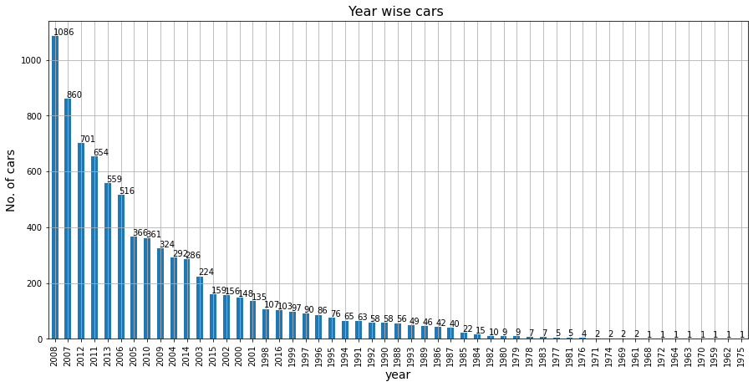
CAR COUNT
We have highest 1086 and 860 cars sell in Year 2008 and 2007 respectively.

Slide 10
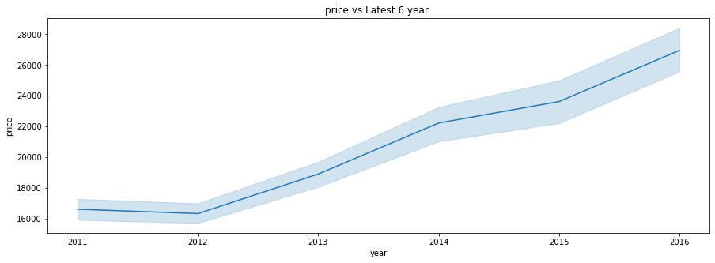
Price
Car Mean price over the year is Increase

Slide 11
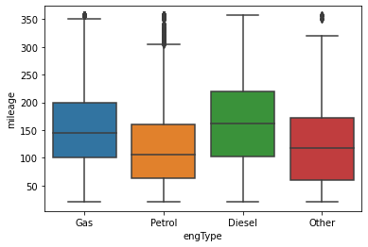
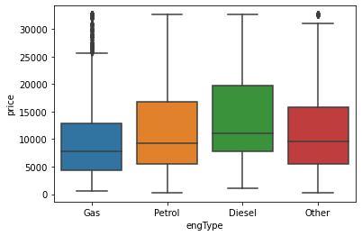
Engine type
Gas and Diesel engine provides higher mileage.
Gas car are more affordable.

Slide 12
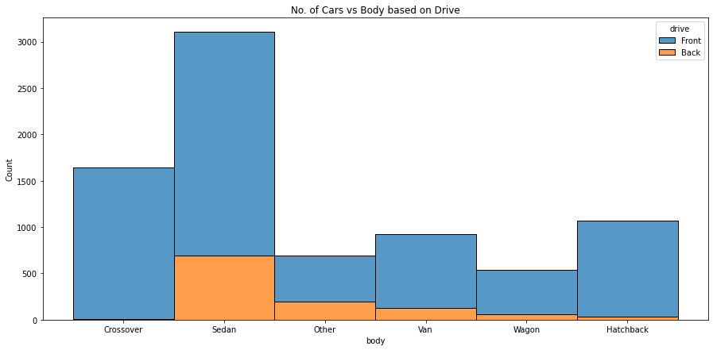
body
Most of the car preferred Front drive.

Slide 13
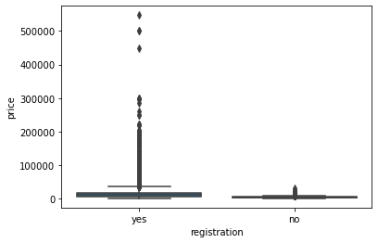
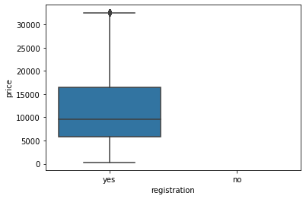
Registration
BEFORE
AFTER
Car without registration price is very less than the car registration price.
I considered in analysis only those vehicles whose registration is done

Slide 14
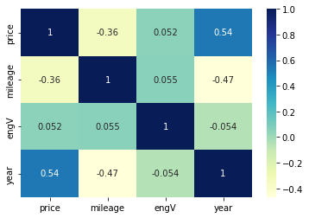
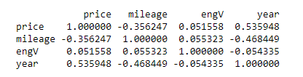
Correlation
Heat Map
Correlation between mileage vs price or Year is negative but The correlation between
engV vs Price which is positive.

Slide 15
Conclusion
2007 and 2008 car Volume is higher than all years.
Volkswagen, Mercedes-Benz and BMW are the Top 3 car selling brand.
Most cars happening price range is between 2000 to 15000 .
There are very few cars sold in 20000 to 33000 price bracket, which is best competitive price range.
Most cars happening Mileage range is belong to 50 to 200 and very less Cars in range of after 250.
Gas and Diesel engine provides higher mileage.
Even with affordable price range, gas engine type cars are least preferred.
Front wheel drive cars mostly opted by customers. Back wheel drive car sales are very least preferred by customers.
Most preferred engine types are Petrol and Diesel.
Irrespective of tenure, Sedans are always on demand follows with Cross-over and Hatchback But in Last 6 year Crossovers are leading in sales followed by sedans.
From 2015,the car price of other engType or Wagon body type drastically decreases and from 2014 Van body type price are increase .
As we know that demands of car are decrease over the year and also the same situation in the top 5 selling company Car Brand but in which BMW and VAZ are doing good in recent year or Volkswagen are remain same.

Slide 16
Actionable insights
Cars should be available in all price ranges.
As 2000 to 15000 /- $ is the most sales happening price range and there are very few cars sold in 20000 to 33000 price bracket, which is best competitive price range., procuring these price ranged cars should potentially improves the sales, Sense the customer likelihood and also market more such cars.
Petrol and Diesel cars are most popular.
Front wheel drive is most preferred in all type of car. So bring more inventory from most value for money branded cars like Mercedes-Benz, Toyota, BMW, Volkswagen etc.. with front wheel drive.
Market & Procure more latest, future ready and sophisticated cars like Engine type other (Hybrid and Electric cars). Despite the fact that car sales fluctuated across years, the Other cars sales are consistent and seen ramp up in sales recently with lesser price.
Immediate tactical approach and Impressive strategic approach
Tactical Approach Less preferred old cars should be announced with great deals and clear the stock. In that way we can save money, renting space for storage Procure more demanded cars like Mercedes-Benz, BMW, Volkswagen, Toyota, Vaz, Audi.. Etc.
Strategic Approach Economy cars are ideally most selling. And most recent economy car are gas engines which are not preferred by customers. So procure more Economy price range cars which is of Petrol or Diesel engine type

Slide 17


